Slide 1

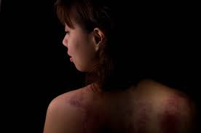
DOMESTIC ABUSE
“Domestic abuse is defined as any incident or pattern of incidents of controlling, coercive, threatening, degrading and violent behaviour, including sexual violence, usually by a partner or ex-partner, but also by a family member or carer”
Women’s Aid

Slide 2
THE FACTS
Not just physical and sexual violence; often psychological, emotional or economic abuse too
Mainly perpetrated by men, against women, but also occurs against men by women and in same-sex relationships
2 million people suffer domestic abuse each year
In 2016/17, 82 women and 13 men were killed by their partner or ex-partner
A domestic abuse crime occurs EVERY MINUTE in England and Wales
Around 30 women a week attempt suicide and 3 women kill themselves each week, as a result of being subjected to domestic abuse
140,000 children live in households where serious domestic abuse takes place

Slide 3
TYPES OF ABUSE
Sexual abuse and rape (including within a relationship)
Physical violence
Financial abuse
Taking control over someone’s everyday life, eg where they go, what they wear
Monitoring or controlling someone’s emails, text messages or social media accounts
Threats to kill or harm
Harassment and stalking

Slide 4

COERCIVE OR CONTROLLING BEHAVIOUR
In 2015 the government created a new offence of Coercive or Controlling Behaviour.

Slide 5
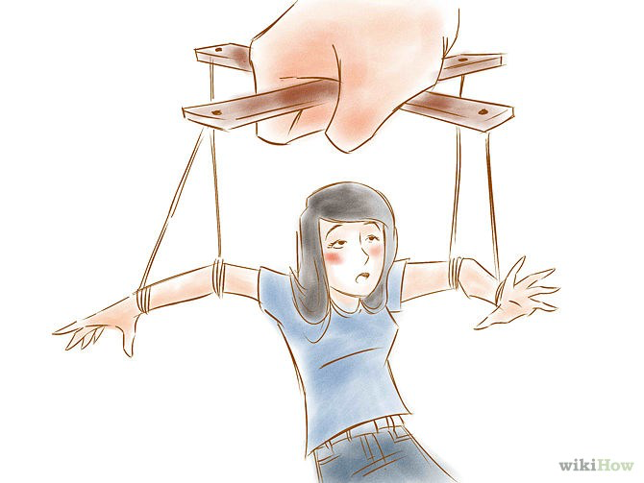
COERCIVE CONTROL
Extreme psychological and emotional abuse
An ongoing pattern of behaviour
The victim feels isolated, intimidated, and in fear.
Can include:
Making unreasonable demands
Monitoring their whereabouts using GPS, and constantly checking up on them
Isolating them from friends and family
Putting them down in front of others
Forcing them to commit crime
Threatening them, their family or pets
Online and digital abuse

Slide 6
ONLINE OR DIGITAL ABUSE
Monitoring or controlling someone’s Facebook account
Abusing someone over WhatsApp or Snapchat accounts
The use of digital or online tools to torment someone, eg…
Revenge porn
Using spyware or GPS on someone’s phone or computer to track their whereabouts

Slide 7
FINANCIAL ABUSE
Financial abuse is often the first sign of further emotional or domestic abuse, and can prevent people from leaving a relationship. It can include:
Spending someone’s money or property without their consent, or borrowing money and never repaying it
Controlling how much money someone is given, such as giving them a small allowance and making them beg for more
Forbidding someone from having a bank account
Forcing someone to take out a loan, or taking out a loan or credit card in someone’s name and racking up debts or deliberately ruining their credit rating
Squandering or gambling away family resources
Preventing someone from getting a job or education

Slide 8
SPOTTING THE SIGNS
Some indicators that someone might be in an abusive relationship:
They stop socialising and withdraw into themselves – they might leave their job or college
They seem nervous or frightened of their partner’s reaction to things they’ve done. They might refuse to appear in photos in case their partner sees them on social media
They don’t have control over their money
Their partner gets jealous a lot and constantly checks up on them
Their partner belittles them in public
They have unexplained injuries, or wear clothes that cover up their body

Slide 9
HOW TO HELP
If someone is in immediate danger, call the police on 999.
If you are worried about children caught up in the abuse, contact their school and talk to the safeguarding team, or call the NSPCC.
If you are worried about someone you know, try talking to them about what’s happening. If they will open up to you, encourage them to seek help, and let them know where help is available.
But Women’s Aid advises that you should not report the abuse to the authorities on their behalf. As well as being very disempowering, this can be very risky and can result in consequences for the victim that you cannot foresee.

Slide 10
HAVING THE CONVERSATION
If you ask someone whether they are suffering from abuse, they are more likely to admit to it than if you wait for them to say something. People are also much more likely to confide in a friend or someone close to them, than the police or professional services.
Here’s some advice about how to have the conversation:
Always have the conversation face-to-face. Make sure you are in a safe space, won’t be interrupted or overheard, and have enough time to have the chat
Approach the subject with obvious kindness and concern. Let them know you are there for help and support.
Start off by asking how things are in their relationship, or mention things you have noticed in their behaviour or that of the abuser. For example:

Slide 11
HOW TO START
I’ve noticed you seem a bit down, has anyone upset you?
I’m worried about you – I saw the way he looked at you and you seemed scared
We haven’t seen much of you recently, is everything ok?
Wow, she texts you a lot! Does she do that all the time?

Slide 12
POINTS TO GET ACROSS
Let them know you want to help
Let them know you believe them
Let them know that help is out there and where to find it
Thank them for their bravery
Reassure them the abuse is not their fault

Slide 13
WHAT NOT TO SAY
It sounds like you are both as bad as each other
Don’t pass judgement. Don’t say things like:
Really?!
That seems so unlike him!
But everyone has arguments, don’t they
Never offer advice – leave that to the experts.
Never tell them to leave the relationship immediately – this can be very risky and there may be many reasons why they can’t. They are the expert in their own situation.

Slide 14
LISTEN
REMEMBER….
You don’t need to have all the answers. Just by listening you will be helping to break the silence around the situation.
Ask them what they want to happen next, so that they feel in control of the situation.
Emphasise that you are not in a position to give advice; only the experts can.
Ending a relationship with an abusive person is a difficult and risky decision. They may take some time to work out how to do it safely. Don’t pressure them.
If they say there’s nothing wrong or they don’t want to talk about it, that’s fine too.
Just let them know you’re there for them if they ever do want to talk.

Slide 15
PRACTICAL SUPPORT
People who have escaped from abusive relationships often say how helpful it was to get practical support from people they know. Here are some ways you might help:
Storing an emergency bag for them, containing items such as their passport, birth certificate, medication, spare keys, clothes, toys for the children
Being with them when they call helplines or support services
Going with them to appointments
Helping them work out a plan for leaving
Helping them to move to a safe place
Letting them stay at your home for a short time
Looking after their children so the person has time to think, plan and receive support.

Slide 16
WHERE THEY CAN GET HELP
Stress that you cannot give them advice, only the experts can. But there are lots of places they can seek help safely:
There are 24-hour National Domestic Violence Helplines and websites in all four nations of the UK:
In England call 0808 2000 247
In Wales call 0808 80 10 80
In Northern Ireland call 0808 802 1414
In Scotland call 0800 027 1234
You can also call these helplines for support and advice if you are worried about someone you know, or are struggling to cope with the pressure of helping someone deal with their abuse.
Local domestic abuse services can be found on the Domestic Abuse Directory at
www.womensaid.org.uk/domestic-abuse-directory

Slide 17
SPECIALIST SERVICES
Karma Nirvana is the specialist helpline for forced marriage and honour-based abuse. It is open Monday to Friday 9am to 5pm on 0800 5999 247.
FORWARD is the charity working on the issue of FGM.
Galop is a charity which runs the LGBT+ Domestic Abuse Helpline 0800 999 5428
Men’s Advice Line, for male victims, is at 0808 801 0327
Suzy Lamplugh Trust runs the National Stalking Helpline and Revenge Porn Helpline on 0345 6000 459
The Respect Phoneline is for men who want to stop being abusive towards their partner: 0808 802 4040

Slide 18
COVERING TRACKS ONLINE
Using the internet to find out about the options available to someone in an abusive relationship can be risky, if the abuser were to find out what they were searching for.
If someone is worried about someone else seeing what they have been doing online, it is best to use a different computer, either at a local library, internet cafe, at a friend's house or at work.
Women’s Aid has more information about covering your tracks online at this link: https://www.womensaid.org.uk/cover-your-tracks-online

Slide 19
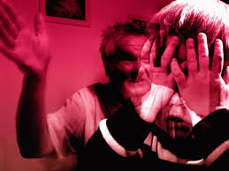
PROTECTING CHILDREN
BUT – if children are involved and you are worried about their safety or welfare, you can call the NSPCC on 0808 800 5000, or contact the child’s school and ask their safeguarding team to investigate.

Slide 20
“HONOUR” CRIMES
Domestic abuse is part of violence against women and girls, which also includes different forms of family violence such as
forced marriage
female genital mutilation
so-called “honour-based abuse”
These are committed mainly by family members.
The perpetrators, and sometimes even the victims, may not recognise these activities as crimes or accept that they are, but UK law is very clear: ALL of these are criminal acts.

Slide 21

FORCED MARRIAGE
Forced marriage is where someone is forced to marry against their will, usually by parents, family or religious leaders.
Victims can be subject to threats, physical or sexual violence, or emotional or psychological blackmail, if they resist.
Forced marriage is not a problem specific to one country or culture. The Forced Marriage Unit (FMU) has handled cases relating to over 100 countries across Asia, the Middle East, Africa, Europe and North America.
Most forced marriages involving British girls and women take place abroad.

Slide 22
FORCED MARRIAGE – the numbers
The Government’s Forced Marriage Unit receives around 1,500 calls a year about actual or possible marriages
80%
are female
6,099
The number of visits to ChildLine’s forced marriage webpage last year
20% are male
Most victims of forced marriage are aged
25 or under

Slide 23
FGM
Female genital mutilation (FGM) is where the female genitals are deliberately cut for non-medical reasons. Some of the reasons given by perpetrators are cleanliness, religious requirements, ensuring chastity, protecting family honour, and better marriage prospects.
It is often carried out in secret, in non-sterile conditions and can have serious health effects, even death.
When carried out on girls, it is child abuse. It has been illegal in the UK since 1985 and convicted offenders face up to 14 years in prison.
There are no health benefits and it is recognised internationally as a human right violation.
FGM is mainly practised in at least 29 countries in the western, eastern and north-eastern regions of Africa, in some countries in the Middle East and Asia, as well as among migrants from these areas in Europe, including in the UK. https://www.forwarduk.org.uk/wp-content/uploads/2019/06/Forward-FAQ-August-2019-New-Branding-WEB.pdf

Slide 24
FGM – the numbers
....only about 20 of these take place in the UK. The vast majority are taken overseas to be cut
137,000 women and girls in the UK have been subjected to it
Over 130 million girls and women have already undergone FGM worldwide
There are around 1,000 newly recorded cases of FGM in the UK every 3 months….
60,000 girls under 15 in the UK are at risk of FGM
Over ¾ of cases recorded in the UK involve girls aged 10 or younger

Slide 25
HONOUR-BASED ABUSE
Honour-based abuse is a form of domestic abuse carried out in order to protect the so-called “honour” of a family or community.
The code of “honour” to which it refers is set by the male members of the family, and women who break the rules of the code are punished for bringing a shame upon the family.
Women can be subjected to honour-based punishments for trying to:
Divorce or separate
Start a new relationship
Talk to or interact freely with men
Have relationships or marry outside a particular religion
Have sex before marriage
Marry a person of their own choice
Attend college or university

Slide 26
HONOUR-BASED ABUSE
Forms of honour-based abuse can include:
Murder
Forced marriage
Domestic violence
Sexual violence
Threats to kill
Pressure to go or move abroad
House arrest and restrictions of freedom
Isolation from family and friends
Who is most at risk?
Honour crimes are most prevalent within diaspora communities from South Asia, the Middle East, and North and East Africa.

Slide 27
SPOTTING THE SIGNS
Some of the indicators that a young person is at risk from these types of abuse include:
The young person suddenly withdraws from their friends, won’t return texts or messages, and disengages from school
The young person suddenly goes away on holiday, especially in the summer
The young person has siblings who were forced to marry or were married very young
The young person has older siblings who were forced to marry
The young person sports bruises, possibly on their upper arms

Slide 28

RIGHT TO CHOOSE
A short film by the Foreign & Commonwealth Office

Slide 29
HOW TO HELP
If you are worried that someone you know is about to married against their will – either in the UK or to be taken abroad, you should contact the Forced Marriage Unit on 020 7008 0151 or call the charity Karma Nirvana on 0800 5999 247. You should give as many details as you can.
If someone is at imminent risk of FGM, call the police immediately. You can also call the charity FORWARD on 020 8960 4000, or the dedicated NSPCC Helpline on 0800 028 3550.
If you are concerned that someone is a victim of honour-based abuse, call the National Domestic Violence Helpline on 0808 2000 247.
NEVER raise the issue with the family of the victim.
This will only increase the risk of harm to the victim.

Slide 30
FOR MORE INFO…
PLEASE VISIT
www.ourwatch.org.uk/crimes-archive/domestic-abuse/
THANK YOU FOR LISTENING

